Slide 1
More About Recursive Data Types
CS 5010 Program Design Paradigms “Bootcamp”
Lesson 5.6
© Mitchell Wand, 2016-2017
This work is licensed under a Creative Commons Attribution-NonCommercial 4.0 International License.
TexPoint fonts used in EMF.
Read the TexPoint manual before you delete this box.: AAA

Slide 2
Introduction
We've just seen several examples of data definitions for recursive data
In this lesson we’ll learn more about the characteristics of a good data type definition and explore how functions on a recursive data type work.

Slide 3
Key Points for Lesson 5.6
TK.

Slide 4
Multiple constructors
In order to define recursive data, we introduced data definitions with multiple constructors, e.g.:
;; CONSTRUCTOR TEMPLATES:
;; -- (make-leaf Number)
;; -- (make-node Tree Tree)
;; CONSTRUCTOR TEMPLATES:
;; empty
;; (cons bs inv)
;; -- WHERE ...
CONSTRUCTOR TEMPLATES
for NonEmptyXList:
-- (cons X empty)
-- (cons X NonEmptyXList)

Slide 5
Properties of a good data definition for recursive data
There are one or more base cases that do not use recursion
The cases are mutually exclusive
It is easy to tell the alternatives apart
There is one and only one way of building any value.
There is an interpretation for each case.

Slide 6
Did our definitions have these properties?
Go back now and check to see that our definitions have these properties.
All the definitions we (and you) will write will have these properties.

Slide 7
Observer templates always recur on smaller pieces of data
Our observer templates embody the principle that the shape of the program follows the shape of the data.
This means that our functions always recur on smaller pieces of the data.
Let’s first see what that means for lists

Slide 8
The Shape of the Program Follows the Shape of the Data: Lists
Xlist
xlist-fn
is-component-of
calls
Data Hierarchy (a non-empty Xlist contains another Xlist)
Call Tree (xlist-fn calls itself on the component)

Slide 9
Let’s watch this in action: remember nl-sum
;; nl-sum : NumberList -> Number
(define (nl-sum lst)
(cond
[(empty? lst) 0]
[else (+ (first lst)
(nl-sum (rest lst)))]))

Slide 10
Watch this work:
(nl-sum (cons 11 (cons 22 (cons 33 empty))))
= (+ 11 (nl-sum (cons 22 (cons 33 empty))))
= (+ 11 (+ 22 (nl-sum (cons 33 empty))))
= (+ 11 (+ 22 (+ 33 (nl-sum empty))))
= (+ 11 (+ 22 (+ 33 0)))
= (+ 11 (+ 22 33))
= (+ 11 55)
= 66

Slide 11
Clearly, this function will halt for any NumberList
Why?
Because at every step it works on a shorter and shorter list, so eventually it reaches empty? and the function halts.

Slide 12
Let’s try something more complicated
What about descendant trees?
Remember the constructor templates:
;; CONSTRUCTOR TEMPLATES:
;; For Person:
;; (make-person String PersonList)
;; For PersonList:
;; empty
;; (cons Person PersonList)

Slide 13
The Shape of the Program Follows the Shape of the Data: Descendant Trees
is-component-of
calls
Person
PersonList
person-fn
plist-fn
is-component-of
calls
Data Hierarchy: Person contains PersonList as a component; and PersonList has Person as a component
Call Tree: person-fn calls plist-fn, and plist-fn calls person-fn.

Slide 14
Template: functions come in pairs
;; person-fn : Person -> ??
(define (person-fn p)
(... (person-name p)
(plist-fn (person-children p))))
;; plist-fn : PersonList -> ??
(define (plist-fn ps)
(cond
[(empty? ps) ...]
[else (... (person-fn (first ps))
(plist-fn (rest ps)))]))
Here is the pair of templates that we get by applying the recipe to our data definition.
They are mutually recursive, as you might expect.

Slide 15
Let’s look at our old example again
(define alice (make-person "alice" empty))
(define bob (make-person "bob" empty))
(define chuck (make-person "chuck" (list alice bob)))
(define dave (make-person "dave" empty))
(define eddie
(make-person "eddie" (list dave)))
(define fred
(make-person
"fred"
(list chuck eddie)))
fred
chuck
eddie
alice
bob
dave

Slide 16
Let's look at the data structure
A Person consists of a String and a PersonList
a Person
a PersonList
"fred"
a String
"chuck"
"eddie"
"alice"
"bob"
"dave"

Slide 17
(person-children p) is always a smaller structure than p.
person1 =
(person-name person1) = "fred"
(person-children person1) =
"fred"
"chuck"
"eddie"
"alice"
"bob"
"dave"

Slide 18
Another example: sum
;; sum :
;; NonNegInt NonNegInt -> NonNegInt
;; strategy: use template for
;; NonNegInt on x
(define (sum x y)
(cond
[(zero? x) y]
[else (+ 1 (sum (- x 1) y))])

Slide 19
Example
(sum 3 2)
= (+ 1 (sum 2 2))
= (+ 1 (+ 1 (sum 1 2)))
= (+ 1 (+ 1 (+ 1 (sum 0 2))))
= (+ 1 (+ 1 (+ 1 2)))
= 5

Slide 20
This one will also work for any non-negative integer x
At every recursive call, the value of the first argument decreases, so eventually it reaches 0.
The value of x is a quantity that decreases at every recursive call.
So this example is consistent with our hypothesis.

Slide 21
Let's look at another example
;; foo : NonNegReal -> NonNegInt
(define (foo n)
(cond
[(zero? n) 0]
[else (+ 1 (foo (* n 0.1)))]))
This is a silly function, so we won't write out the rest of the purpose statement.

Slide 22
(foo 3)
= (+ 1 (foo 0.3))
= (+ 1 (+ 1 (foo 0.03)))
= (+ 1 (+ 1 (+ 1 (foo 0.003))))
= ...
Oops! The argument is never equal to 0, so the function never halts.

Slide 23
So we can refine our hypothesis
If we can find a integer-valued quantity that decreases at every recursive call to our function, then the function always halts.
All our examples are consistent with this hypothesis.

Slide 24
Let's try another example
;; sum2 :
;; NonNegInt NonNegInt -> NonNegInt
;; strategy: use template for
;; NonNegInt on x
(define (sum2 x y)
(cond
[(zero? x) y]
[else (+ 2 (sum2 (- x 2) y))])
What if we had used the template incorrectly, and written this program instead?

Slide 25
It still works for even x
(sum2 4 3)
= (+ 2 (sum2 2 3))
= (+ 2 (+ 2 (sum2 0 3)))
= (+ 2 (+ 2 3))
= 7

Slide 26
But watch what happens when x is odd
(sum2 3 3)
= (+ 2 (sum2 1 3))
= (+ 2 (+ 2 (sum2 -1 3)))
= (+ 2 (+ 2 (+ 2 (sum2 -3 3))))
= (+ 2 (+ 2 (+ 2 (+ 2 (sum2 -5 3)))))
= ...
Oops! The value of x went negative without being 0. This goes into an infinite loop!

Slide 27
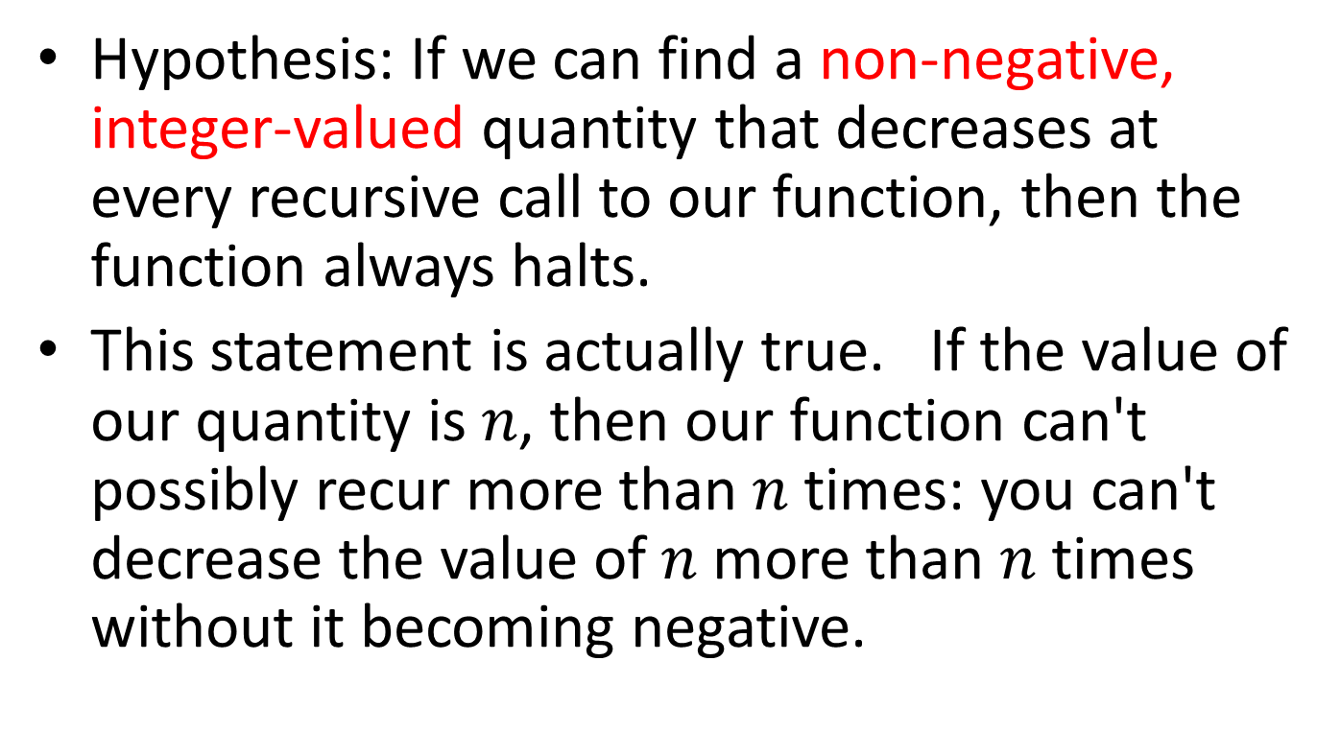
So let's refine our hypothesis again
Hypothesis: If we can find a non-negative, integer-valued quantity that decreases at every recursive call to our function, then the function always halts.
This statement is actually true. If the value of our quantity is $n$, then our function can't possibly recur more than $n$ times: you can't decrease the value of $n$ more than $n$ times without it becoming negative.

Slide 28
Halting Measure
Definition: a halting measure for a particular function is an integer-valued quantity that can't be less than zero, and which decreases at each recursive call in that function.
This is something you have probably not seen before, so you'll need to pay careful attention.

Slide 29
Examples
(length lst) is a halting measure for nl-sum
the value of x is a halting measure for sum
the value of y is a halting measure for prod (Lesson 4.4).

Slide 30
A function may have more than one halting measure
The following quantities are halting measures for sum:
the value of x
the value of x+4
the value of 2*x
The following quantities are not halting measures for sum:
the value of y
the value of -2*x
But usually there's one "obvious" halting measure, like the ones on the preceding slide.

Slide 31
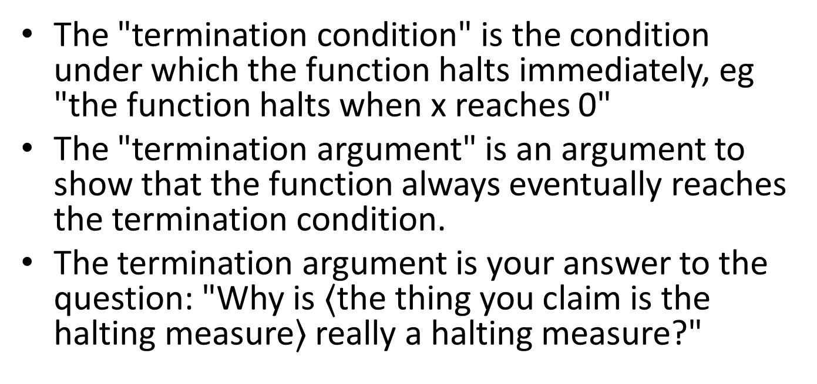
Don't get confused: "Termination Argument" vs. "Termination Condition"
The "termination condition" is the condition under which the function halts immediately, eg "the function halts when x reaches 0"
The "termination argument" is an argument to show that the function always eventually reaches the termination condition.
The termination argument is your answer to the question: "Why is $〈$the thing you claim is the halting measure$〉$ really a halting measure?"

Slide 32
The Halting Measure is a new deliverable
We will ask you to specify a halting measure for every recursive function you write.
This is usually easy, eg:
HALTING MEASURE: the length of lst
or the like.
When you follow the template, it will almost always be a quantity associated with the template variable.
The TA may ask you to explain why the thing you called the halting measure really is a halting measure for your function.

Slide 33
Summary
At the end of this lesson you should be able to:
Identify the halting measure for functions that follow a template
Document the halting measure for such functions

Slide 34
Next Steps
Study 04-XXX in the Examples file
If you have questions about this lesson, ask them on the Discussion Board
Do Guided Practice 4.4++
Go on to the next lesson
GPs: take some from Lesson 8.2, add some for lists.

Slide 35
Outtakes

Slide 36
Let's add this to the recipe for writing a template
Question | Answer
Does the data definition distinguish among different subclasses of data? | Your template needs as many cond clauses as subclasses that the data definition distinguishes.
How do the subclasses differ from each other? | Use the differences to formulate a condition per clause.
Do any of the clauses deal with structured values? | If so, add appropriate selector expressions to the clause.
Does the data definition use self-references? | Formulate ``natural recursions'' for the template to represent the self-references of the data definition.
We got the list template by following the template recipe and adding one more step.

Slide 37
Let's see how the four steps in the template recipe show up in the list template.
;; seq-fn : XList -> ??
(define (seq-fn lst)
(cond
[]
[]))
;; seq-fn : XList -> ??
(define (seq-fn lst)
(cond
[(empty? lst) ...]
[else ...]))
;; seq-fn : XList -> ??
(define (seq-fn lst)
(cond
[(empty? lst) ...]
[else (... (first lst)
(rest lst))]))
;; seq-fn : XList -> ??
(define (seq-fn lst)
(cond
[(empty? lst) ...]
[else (... (first lst)
(seq-fn (rest lst))]))
1. Write a cond clause with the correct number of clauses.
2. Write predicates that distinguish the cases.
3. For mixed data, add selectors
4. For recursive data, add a recursive call
1. Write a cond clause with the correct number of clauses.
2. Write predicates that distinguish the cases.
3. For mixed data, add selectors
4. For recursive data, add a recursive call
1. Write a cond clause with the correct number of clauses.
2. Write predicates that distinguish the cases.
3. For mixed data, add selectors
4. For recursive data, add a recursive call
1. Write a cond clause with the correct number of clauses.
2. Write predicates that distinguish the cases.
3. For mixed data, add selectors
4. For recursive data, add a recursive call
Observe that (cons X XList) was a structured value, and that (first lst) and (rest lst) were the appropriate selector expressions

Slide 38
From Observer Template to Function Definition
Remember that when we use a template, all we do is fill in the blanks.
For each blank, we had a question to answer:
"What's the answer for a red light?"
"What's the answer for a yellow light?"
"What's the answer for a green light?"
The questions are the same, no matter what the function is.

Slide 39
Template Questions for TLState
What's the answer for "red"?
;; tls-fn : TLState -> ??
;(define (tls-fn tls)
; (cond
; [(string=? tls "red") ...]
; [(string=? tls "yellow") ...]
; [(string=? tls "green") ...]))
What's the answer for "yellow"?
The questions are the same, no matter what function we are defining.
To finish the function definition, all we do is to fill in the blanks with the answers.
What's the answer for "green"?

